Slide 1
Bioinformatics with R R Basics I
Assoc Prof. Dr. Gazi Erkan BOSTANCI
Slides are mainly based on ‘Bioinformatics with R Cookbook’ by Paurush Praveen Sinha

Slide 2
Introduction
Recent developments in molecular biology, such as high throughput array technology or sequencing technology, are leading to an exponential increase in the volume of data that is being generated.
Bioinformatics aims to get an insight into biological functioning and the organization of a living system riding on this data. The enormous data generated needs robust statistical handling, which in turn requires a sound computational statistics tool and environment.
R provides just that kind of environment. It is a free tool with a large community and leverages the analysis of data via its huge package libraries that support various analysis operations.

Slide 3
Before we start dealing with bioinformatics, this chapter lays the groundwork for upcoming chapters. We first make sure that you know how to install R, followed by a few sections on the basics of R that will rejuvenate and churn up your memories and knowledge on R programming that we assume you already have.
This lecture will mostly introduce you to certain functions in R that will be useful in the upcoming chapters, without getting into the technical details.
Here, we will also discuss the technical details of the R programs used.

Slide 4
Getting started and installing libraries
Libraries in R are packages that have functions written to serve specific purposes; these include reading specific file formats in the case of a microarray datafile or fetching data from certain databases, for example, GenBank (a sequence database).
You must have these libraries installed in the system as well as loaded in the R session in order to be able to use them. They can be downloaded and installed from a specific repository or directly from a local path. Two of the most popular repositories of R packages are Comprehensive R Archive Network (CRAN) and Bioconductor.
CRAN maintains and hosts identical, up-to-date versions of code and documentation for R on its mirror sites.
Bioconductor is another repository of R and the associated tool with a focus on other tools for the analysis of high throughput data.

Slide 5
The initialization of R depends on the operating system you are using. On Windows and Mac OS platforms, just clicking on the program starts an R session, like any other application for these systems.
To install packages
From the Packages menu in the toolbar, select Install package(s)....
If this is the first time that you are installing a package during this session, R will ask you to pick a mirror. A selection of the nearest mirror (geographically) is more feasible for a faster download.
Click on the name of the package that you want to install and then on the OK button. R downloads and installs the selected packages.

Slide 6
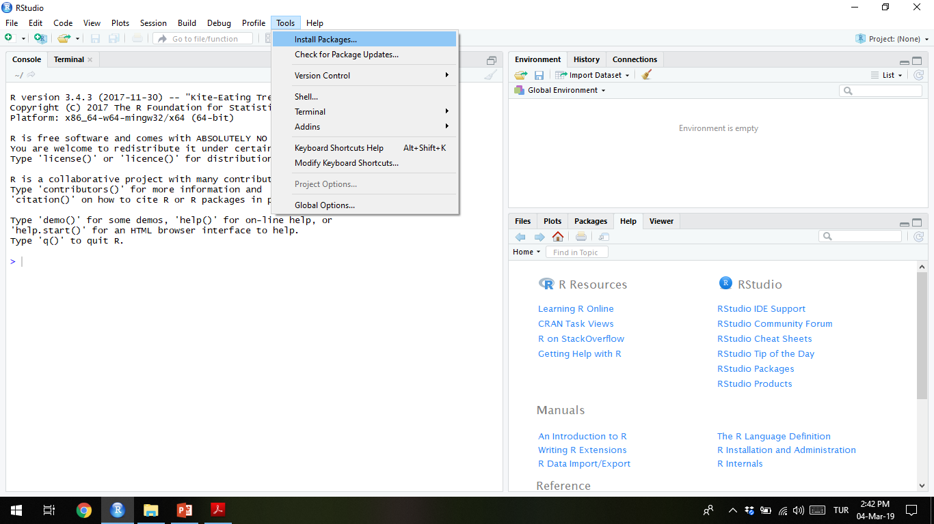

Slide 7
By default, R fetches packages from CRAN. However, you can change this if necessary just by choosing Select repositories... from the Packages menu. You are required to change the default repository or switch the repository in case the desired package is available in a different repository. Remember that a change in the repository is different from a change in the mirror; a mirror is the same repository at a different location.
You can also install packages by issuing
> install.packages("package_name")

Slide 8
To check the installed libraries/packages in R, type the following command:
> library() (Script)
To quit an R session, type in q() at the R prompt, and the session will ask whether you want to save the session as a workspace image or not or whether you want to cancel the quit command.

Slide 9
Few libraries are loaded by default when an R session starts. To load a library in R, run the following command:
> load(package_name)
Loading a package imports all the functions of this specific package into the R session. The default packages in the session can be viewed using the following getOption command:
> getOption("defaultPackages")
The currently loaded libraries in a session can be seen with the following command:
> print(.packages())
An alternative for this is sessionInfo(), which provides version details as well.
All the installed packages can be displayed by running the library function as follows:
> library()

Slide 10
Besides all this, R has a comprehensive built-in help system. You can get help from R in a number of ways. The Windows and Mac OS platforms offer help as a separate HTML page (as shown in the following screenshot) . The following is a list of options that can be used to seek help in R: (script)
> help.start()
> help(sum) # Accesses help file for function sum
> ?sum # Searches the help files for function sum
> example(sum) # demonstrates the function with an example
> help.search("sum") # uses the argument character to search help files

Slide 11
All of the previous functions provide help in a unique way. The help.start command is the general command used to start the hypertext version of the R documentation. All the help files related to the package can be checked with the following command:
> help(package="package_name")

Slide 12
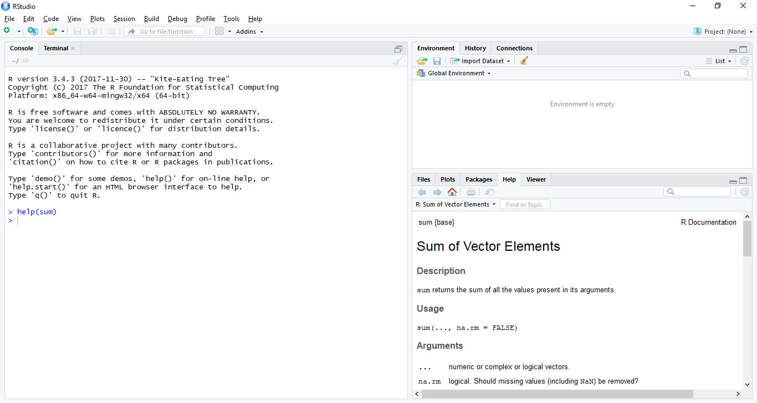

Slide 13
Reading and writing data
Before we start with analyzing any data, we must load it into our R workspace. This can be done directly either by loading an external R object (typical file extensions are .rda or .RData, but it is not limited to these extensions) or an internal R object for a package or a TXT, CSV, or Excel file.
This recipe explains the methods that can be used to read data from a table or the .csv format and/or write similar files into an R session.

Slide 14
We will use an iris dataset for this recipe, which is available with R Base packages.
The dataset bears quantified features of the morphologic variation of the three related species of Iris flowers.

Slide 15
Perform the following steps to read and write functions in R:
1. Load internal R data (already available with a package or base R) using the following data function: (script)
> data(iris)
2. To learn more about iris data, check the help function in R using the following function:
> ?iris
3. Load external R data (conventionally saved as .rda or .RData, but not limited to this) with the following load function:
> load(file="mydata.RData")

Slide 16
4. To save a data object, say, D, you can use the save function as follows: (script)
> save(D, file="myData.RData")
5. To read the tabular data in the form of a .csv file with read.csv or read.table, type the following command:
> mydata <- read.table("file.dat", header = TRUE, sep="\t", row.
names = 1)
> mydata <- read.csv("mydata.csv")

Slide 17
It is also possible to read an Excel file in R. You can achieve this with various packages such as xlsx and gdata. The xlsx package requires Java settings, while gdata is relatively simple. However, the xlsx package offers more functionalities, such as read permissions for different sheets in a workbook and the newer versions of Excel files. For this example, we will use the xlsx package. Use the read.xlsx function to read an Excel file as follows:
> install.packages("xlsx", dependencies=TRUE)
> library(gdata)
> mydata <- read.xls("mydata.xls")

Slide 18
7. To write these data frames or table objects into a CSV or table file, use the read.csv or write.table function as follows:
> write.table(x, file = "myexcel.xls", append = FALSE, quote =
TRUE, sep = " ")
> write.csv(x, col.names = NA, sep = ",")

Slide 19
The read.csv or write.csv commands take the filename in the current working directory—if a complete path has not been specified—and based on the separators (usually the sep argument), import the data frames (or export them in case of write commands).
To find out the current working directory, use the getwd() command. In order to change it to your desired directory, use the setwd function as follows:

Slide 20
setwd("path/to desired/directory")
The second argument header indicates whether or not the first row is a set of labels by taking the Boolean values TRUE or FALSE.
The read.csv function may not work in the case of incomplete tables with the default argument fill. To overcome such issues, use the value, TRUE for the fill argument. To learn more about optional arguments, take a look at the help section of the read.table function. Both the functions (read.table and read.csv) can use the headers (usually the first row) as column names and specify certain column numbers as row names.

Slide 21
To get further information about the loaded dataset, use the class function for the dataset to get the type of dataset (object class). The data or object type in R can be of numerous types. This is beyond the scope of the book. It is expected that the reader is acquainted with these terms.
Here, in the case of the iris data, the type is a data frame with 150 rows and five columns (type the dim command with iris as the argument).
A data frame class is like a matrix but can accommodate objects of different types, such as character, numeric, and factor, within it. You can take a look at the first or last few rows using the head or tail functions (there are six rows by default) respectively, as follows:

Slide 22
(script)
> class(iris)
> dim(iris)
> head(iris), head (iris, 10)
> tail(iris)

Slide 23
The save function in R is a standard way to save an object. However, the saveRDS function offers an advantage as it doesn't save both the object and its name; it just saves a representation of the object.
As a result, the saved object can be loaded into a named object within R that will be different from the name it had when it was originally serialized. Let's take a look at the following example:
> saveRDS(myObj, "myObj.rds")
> myObj2 <- readRDS("myObj.rds")
> ls()
[1] "myObj" "myObj2"

Slide 24
Filtering and subsetting data
The data that we read in our previous recipes exists in R as data frames. Data frames are the primary structures of tabular data in R. By a tabular structure, we mean the row-column format.
The data we store in the columns of a data frame can be of various types, such as numeric or factor. In this recipe, we will talk about some simple operations on data to extract parts of these data frames, add a new chunk, or filter a part that satisfies certain conditions.

Slide 25
The following items are needed for this example:
A data frame loaded to be modified or filtered in the R session (in our case, the iris data)
Another set of data to be added to item 1 or a set of filters to be extracted from item 1

Slide 26
Perform the following steps to filter and create a subset from a data frame:
1. Load the iris data as explained in the earlier recipe.
2. To extract the names of the species and corresponding sepal dimensions (length and width), take a look at the structure of the data as follows: (script)
> str(iris)
'data.frame': 150 obs. of 5 variables:
$ Sepal.Length: num 5.1 4.9 4.7 4.6 5 5.4 4.6 …
$ Sepal.Width : num 3.5 3 3.2 3.1 3.6 3.9 3.4 …
$ Petal.Length: num 1.4 1.4 1.3 1.5 1.4 1.7 1.4 …
$ Petal.Width : num 0.2 0.2 0.2 0.2 0.2 0.4 0.3 …
$ Species : Factor w/ 3 levels "setosa","versicolor",..: 1 1
1 1 1 1 1 1 1 1 ...

Slide 27
3. To extract the relevant data to the myiris object, use the data.frame function that creates a data frame with the defined columns as follows: (script)
> myiris=data.frame(Sepal.Length=iris$Sepal.Length, Sepal.Width=
iris$Sepal.Width, Species= iris$Species)
4. Alternatively, extract the relevant columns or remove the irrelevant ones (however, this style of subsetting should be avoided):
> myiris <- iris[,c(1,2,5)]

Slide 28
5. Instead of the two previous methods, you can also use the removal approach to extract the data as follows: (script)
> myiris <- iris[,-c(3,4)]
6. You can add to the data by adding a new column with cbind or a new row through rbind (the rnorm function generates a random sample from a normal distribution and will be discussed in detail in the next recipe):
> Stalk.Length <-c (rnorm(30,1,0.1),rnorm(30,1.3,0.1), rnorm(30,1.
5,0.1),rnorm(30,1.8,0.1), rnorm(30,2,0.1))
> myiris <- cbind(iris, Stalk.Length)

Slide 29
7. Alternatively, you can do it in one step as follows: (script)
> myiris$Stalk.Length = c(rnorm(30,1,0.1),rnorm(30,1.3,0.1), rnorm
(30,1.5,0.1),rnorm(30,1.8,0.1), rnorm(30,2,0.1))
8. Check the new data frame using the following commands:
> dim(myiris)
[1] 150 6
> colnames(myiris)# get column names for the data frame myiris
[1] "Sepal.Length" "Sepal.Width" "Petal.Length" "Petal.Width"
"Species" "Stalk.Length"

Slide 30
9. Use rbind as depicted: (script)
newdat <- data.frame(Sepal.Length=10.1, Sepal.Width=0.5, Petal.
Length=2.5, Petal.Width=0.9, Species="myspecies")
> myiris <- rbind(iris, newdat)
> dim(myiris)
[1] 151 5
> myiris[151,]
Sepal.Length Sepal.Width Petal.Length Petal.Width Species
151 10.1 0.5 2.5 0.9 myspecies

Slide 31
10. Extract a part from the data frame, which meets certain conditions, in one of the following ways: (script)
One of the conditions is as follows:
> mynew.iris <- subset(myiris, Sepal.Length == 10.1)
An alternative condition is as follows:
> mynew.iris <- myiris[myiris$Sepal.Length == 10.1, ]
> mynew.iris
Sepal.Length Sepal.Width Petal.Length Petal.Width
Species
151 10.1 0.5 2.5 0.9
myspecies
> mynew.iris <- subset(iris, Species == "setosa")

Slide 32
11. Check the following first row of the extracted data: (script)
> mynew.iris[1,]
Sepal.Length Sepal.Width Petal.Length Petal.Width Species
1 5.1 3.5 1.4 0.2 setosa
You can use any comparative operator as well as even combine more than one condition with logical operators such as & (AND), | (OR), and ! (NOT), if required.

Slide 33
These functions use R indexing with named columns (the $ sign) or index numbers. The $ sign placed after the data followed by the column name specifies the data in that column.
The R indexing system for data frames is very simple, just like other scripting languages, and is represented as [rows, columns]. You can represent several indices for rows and columns using the c operator as implemented in the following example.
A minus sign on the indices for rows/ columns removes these parts of the data.
The rbind function used earlier combines the data along the rows (row-wise), whereas cbind does the same along the columns (column-wise).

Slide 34
Another way to select part of the data is using %in% operators with the data frame, as follows: (script)
> mylength <- c(4,5,6,7,7.2)
> mynew.iris <- myiris[myiris[,1] %in% mylength,]
This selects all the rows from the data that meet the defined condition. The condition here means that the value in column 1 of myiris is the same as (matching) any value in the mylength vector. The extracted rows are then assigned to a new object, mynew.iris.

